Slide 1


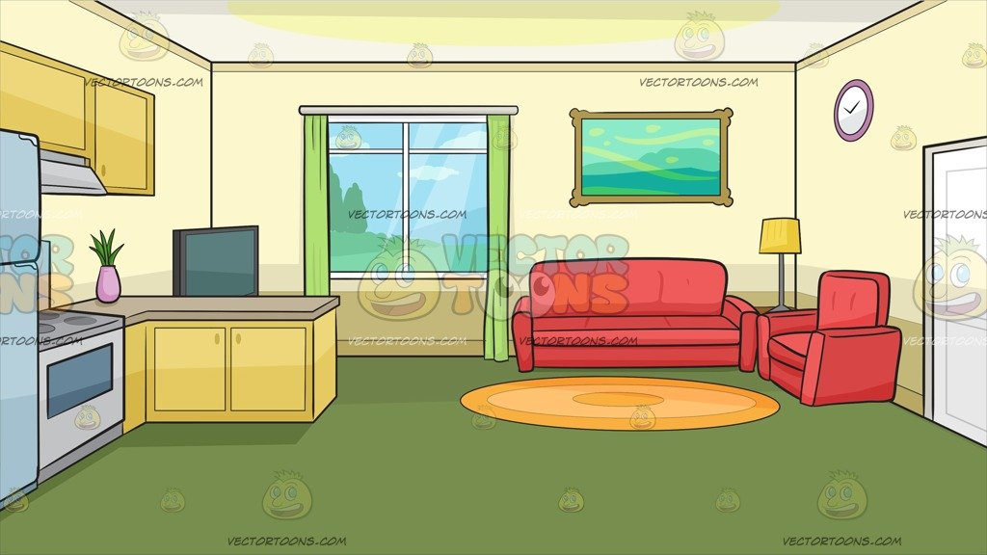
Springboard Data Science Career Track Course - Capstone Project 2
NATURAL LANGUAGE PROCESSING
Sentiment Analysis
Amazon Home and Kitchen Products’ Reviews
Gokmen Oran

Slide 2
Agenda
Introduction
Data Wrangling
Exploratory Data Analysis
Modeling
Summary
Conclusion
Recommendations

Slide 3


Introduction
Problem Statement
Can we predict whether a user liked a product or not based on their reviews?
Classification Model
NLP Sentiment Analysis

Slide 4

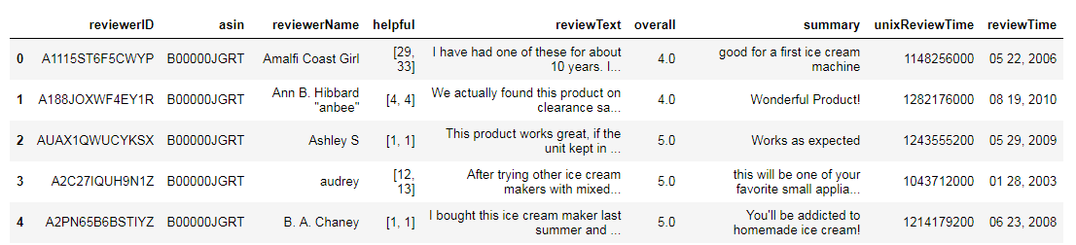
Introduction
Dataset
The dataset comes from consumer reviews of Amazon products which are related with home and kitchen. The data was obtained from Julian McAuley’s dataset collection. This dataset has 25445 Rows (Reviews) and 9 Columns(Variables) in total.
csv file
Format

Slide 5
Introduction
Dataset
Each record has below feature:
reviewerID : ID of the reviewer, e.g. A2SUAM1J3GNN3B - type: object
asin : ID of the product , e.g. 0000013714 – type: object
reviewerName : name of the reviewer – type: object
helpful : helpfulness of the review, e.g. 2/3 – type: object
reviewText : text of the review – type: object
overall : Rating (1,2,3,4,5)– type: float64
summary : summary of the review – type: object
unixReviewTime : time of the review (unix time) – type: int64
reviewTime : time of the review (raw) – type: object

Slide 6
Data Wrangling
No duplicated data.
169 'reviewerName' information was missing ➔Dropped
‘reviewerName’ feature ➔Dropped
‘reviewerID’ feature renamed as ‘customer’
‘asin’ feature named as ‘product’
‘helpful’ feature ➔Dropped
‘reviewText’ feature is concatenated with ‘summary’ and renamed as "review_text“. Later both 'reviewText' and 'summary' feature ➔Dropped
‘Overall’ feature rearranged as ‘Rating_Class’ ( 1,2 ➔Bad, 3,4,5 ➔Good). Later, ‘overall’ feature ➔Dropped
‘unixReviewTime’ feature ➔Dropped
'reviewTime‘ feature was converted to datetime data type and a new 'year' feature was created

Slide 7
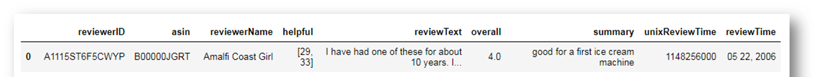
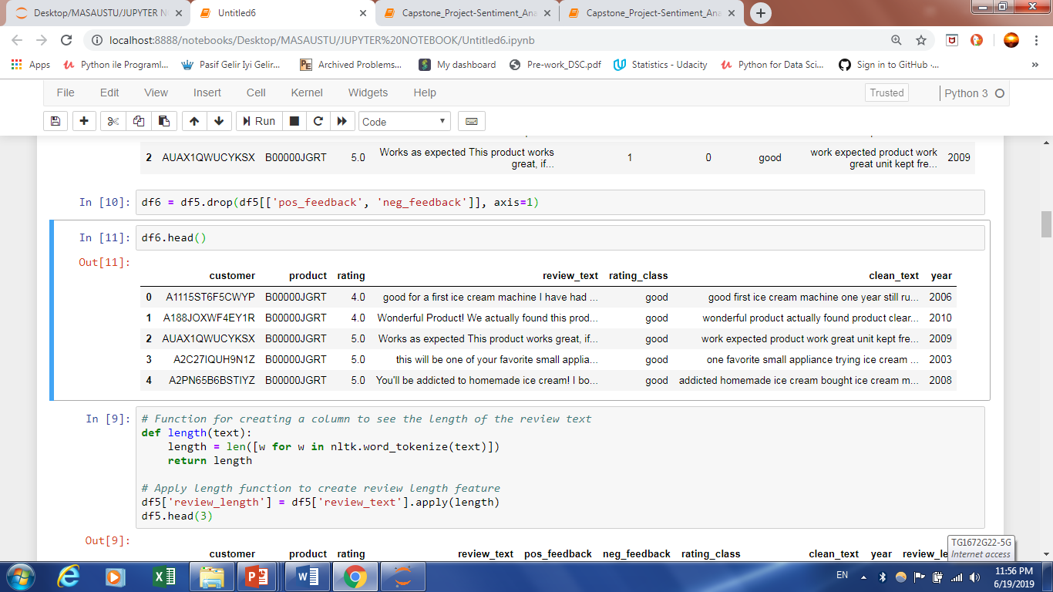
Data Wrangling

Slide 8

Data Wrangling
Descriptive Statistics
Bad Ratings
1276
Imbalanced
Dataset
Good Ratings
24000
There are 1395 unique customers and 1171 products.
Each customer has 18 reviews for products on average.
There is 22 reviews for each product on average.

Slide 9
Data Wrangling
Text Preprocessing
Remove tags
Remove accented characters
Expand contractions
Remove special characters
Lemmatisation versus Stemming
Removing stopwords
Tokenization
Remove extra white space and digits
Spelling corrections
Grammatical Corrections
Remove repeated characters
Lower the text
“review_text" Feature
“clean_text" Feature

Slide 10
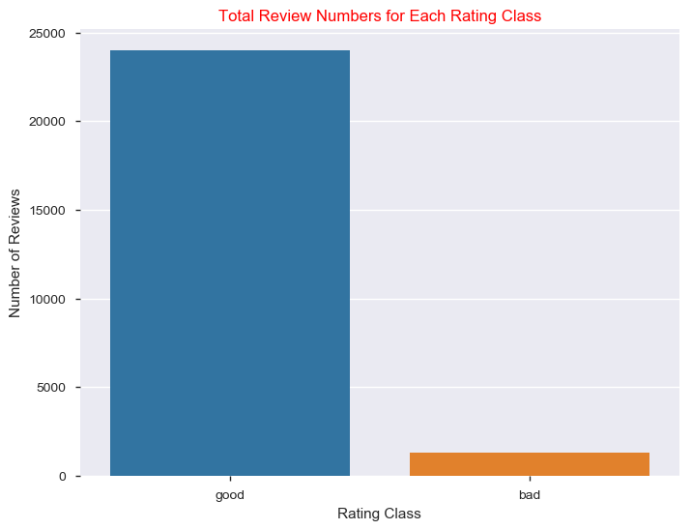
Exploratory Data Analysis
Target Variable :"rating_class" Feature
95% (24000)
5% (1276)

Slide 11
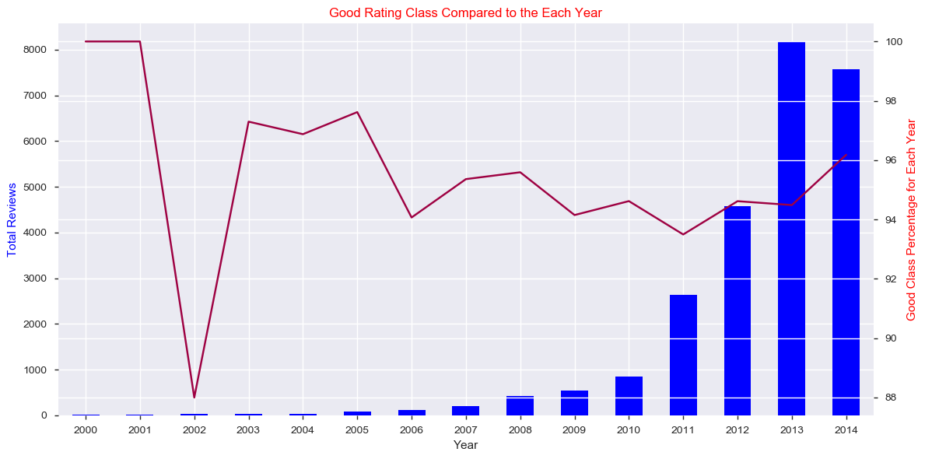
Exploratory Data Analysis
"year" Feature

Slide 12
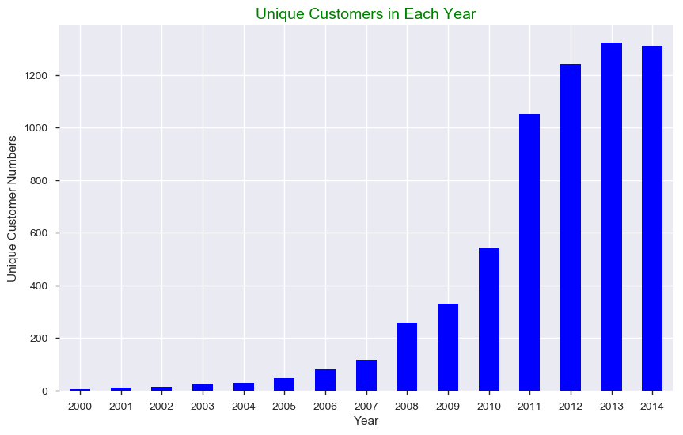
Exploratory Data Analysis
“customer” Feature

Slide 13

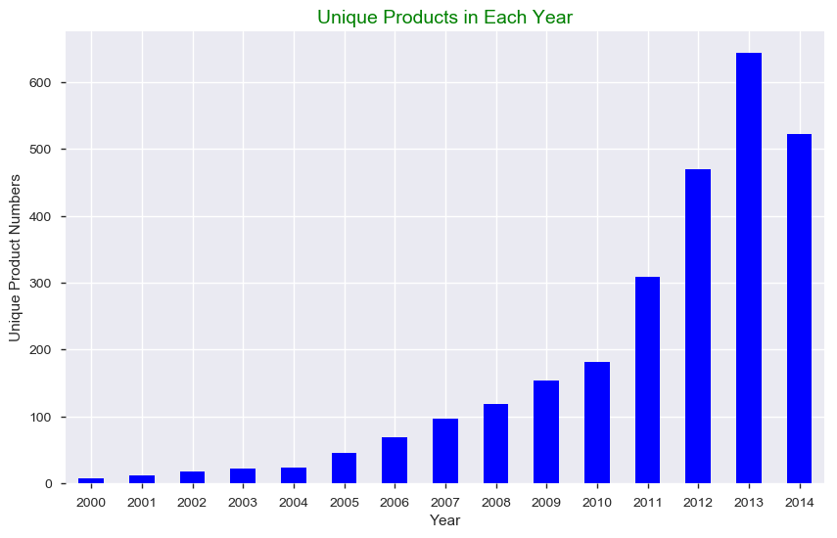
Exploratory Data Analysis
“product” Feature

Slide 14
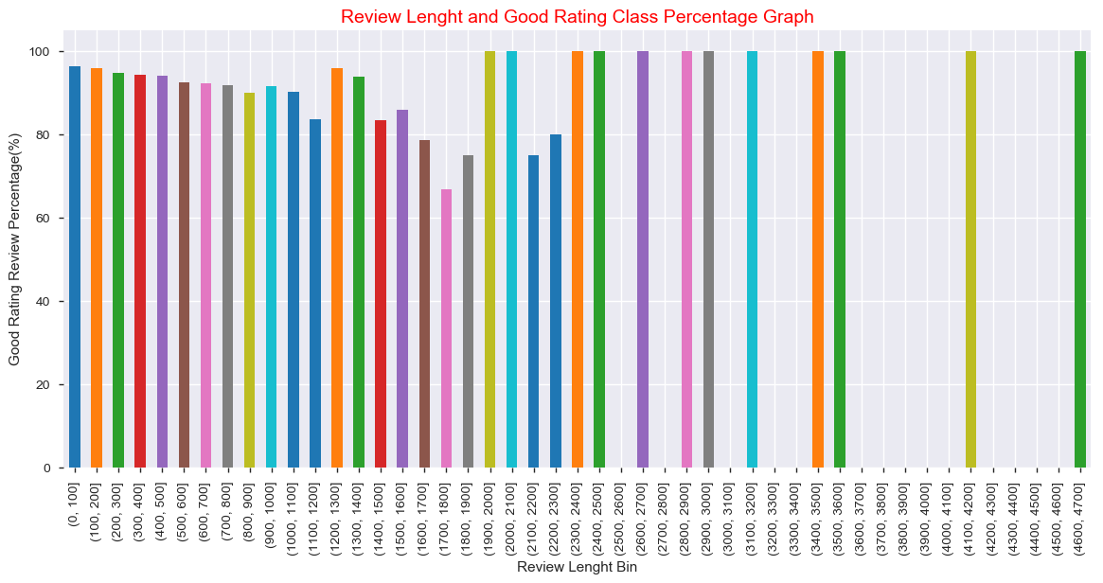
Exploratory Data Analysis
“review_ length” Feature

Slide 15
Exploratory Data Analysis
“clean_text” Feature
Due to computational restrictions, I reduced the number of observations.
I dropped good rating class reviews longer than 150 words.
I dropped all observations earlier than year 2010.
After reducing, there are 8933 observations (7731 "good" reviews and 1202 "bad" reviews

Slide 16
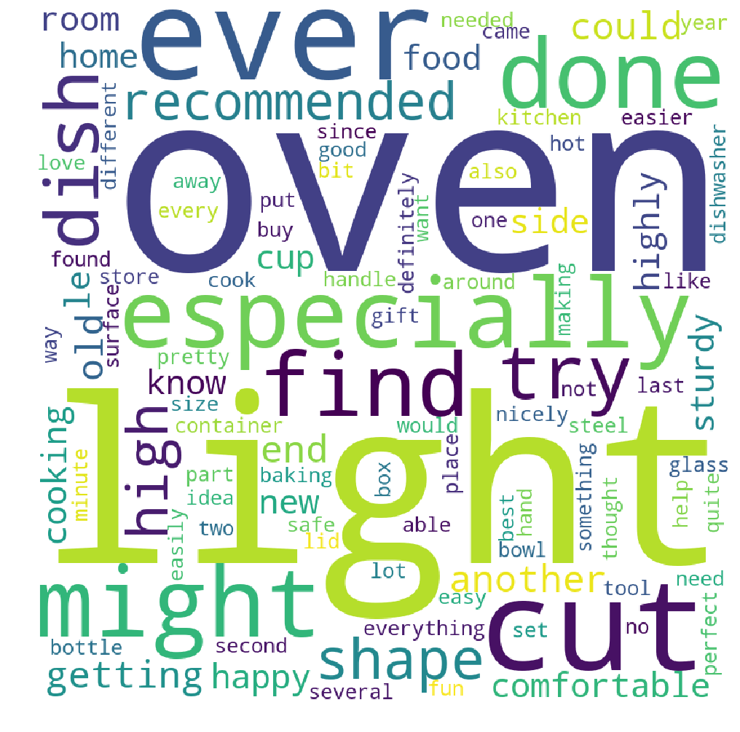
Exploratory Data Analysis
“review_text” Feature - Good Rating Words
 | words | Avg |  | words | Avg |  | words | Avg
1 | oven | 0.91509 | 18 | end | 0.87255 | 35 | nicely | 0.85841
2 | light | 0.91045 | 19 | comfortable | 0.87129 | 36 | second | 0.85833
3 | ever | 0.90291 | 20 | happy | 0.87075 | 37 | set | 0.85827
4 | cut | 0.90099 | 21 | side | 0.87059 | 38 | need | 0.85787
5 | especially | 0.89655 | 22 | new | 0.86957 | 39 | every | 0.85714
6 | might | 0.89381 | 23 | highly | 0.86932 | 40 | definitely | 0.85714
7 | done | 0.89216 | 24 | sturdy | 0.86722 | 41 | something | 0.85714
8 | find | 0.89011 | 25 | cooking | 0.86705 | 42 | baking | 0.85577
9 | try | 0.8882 | 26 | know | 0.86458 | 43 | kitchen | 0.85488
10 | dish | 0.88288 | 27 | room | 0.86441 | 44 | way | 0.85484
11 | shape | 0.87851 | 28 | le | 0.86184 | 45 | glass | 0.85417
12 | high | 0.87845 | 29 | food | 0.8617 | 46 | gift | 0.85402
13 | recommended | 0.87805 | 30 | cup | 0.8617 | 47 | like | 0.85342
14 | getting | 0.87681 | 31 | home | 0.86066 | 48 | best | 0.85326
15 | old | 0.87662 | 32 | everything | 0.86014 | 49 | fun | 0.85294
16 | could | 0.8764 | 33 | needed | 0.85981 | 50 | store | 0.85276
17 | another | 0.87562 | 34 | safe | 0.85976

Slide 17
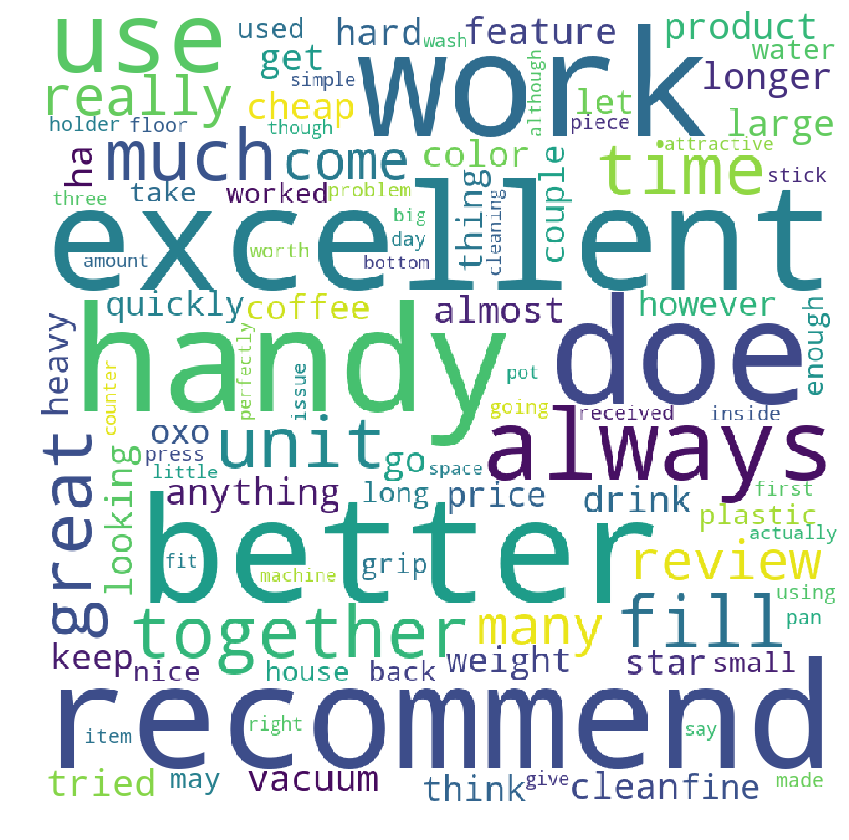
Exploratory Data Analysis
“review_text” Feature - Bad Rating Words
 | words | Avg |  | words | Avg |  | words | Avg
1 | machine | 0.752212 | 18 | say | 0.79835 | 35 | made | 0.80941
2 | perfectly | 0.754717 | 19 | cleaning | 0.8 | 36 | received | 0.80952
3 | bottom | 0.76506 | 20 | right | 0.80091 | 37 | first | 0.80969
4 | fit | 0.776224 | 21 | actually | 0.80272 | 38 | may | 0.81035
5 | big | 0.776786 | 22 | using | 0.80451 | 39 | problem | 0.81035
6 | space | 0.779874 | 23 | issue | 0.80451 | 40 | back | 0.81068
7 | attractive | 0.784314 | 24 | piece | 0.80473 | 41 | water | 0.81108
8 | although | 0.784314 | 25 | inside | 0.80556 | 42 | take | 0.81139
9 | three | 0.787037 | 26 | item | 0.80591 | 43 | nice | 0.81191
10 | amount | 0.790476 | 27 | holder | 0.80734 | 44 | long | 0.81197
11 | though | 0.790698 | 28 | day | 0.80745 | 45 | grip | 0.8125
12 | counter | 0.79085 | 29 | going | 0.80791 | 46 | used | 0.81426
13 | simple | 0.792453 | 30 | floor | 0.80833 | 47 | small | 0.81461
14 | wash | 0.792593 | 31 | stick | 0.8087 | 48 | enough | 0.81544
15 | pot | 0.793103 | 32 | worth | 0.80909 | 49 | worked | 0.81553
16 | give | 0.793548 | 33 | press | 0.80916 | 50 | house | 0.816
17 | little | 0.797849 | 34 | pan | 0.80928

Slide 18
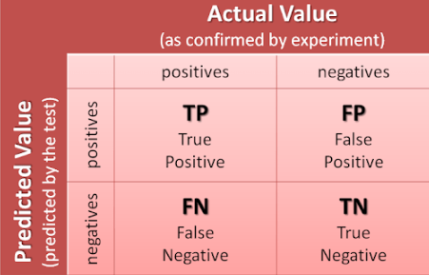

Modeling
Data Preprocessing and Selecting the Right Evaluation Metric
Separating Response Variable and Feature
X = df4['clean_text']
y = df4['rating_class']
Splitting Dataset into Training and Test Set
Test Size = 25%
Stratified Sampling
Train Set Shape : (6699,)
Test Set Shape : (2234,)

Slide 19
Modeling
Vectorizing
Turning a collection of text documents into numerical feature vectors.
CountVectorizer
TF-IDF
Hashing Vectorizer

Slide 20
Modeling
Models
Logistic Regression
Random Forest
Classification
Models
Naïve Bayes
XGBoost
CatBoost

Slide 21
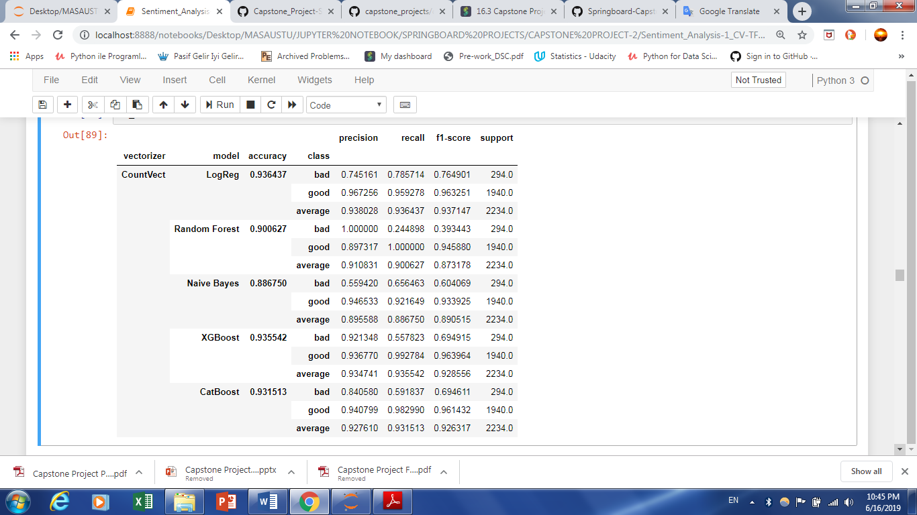
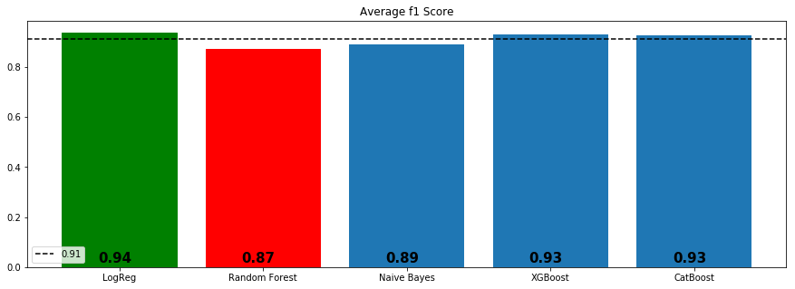
Modeling
Count-Vectorizing and Algorithms
Logistic Regression ➔ 0.937147

Slide 22
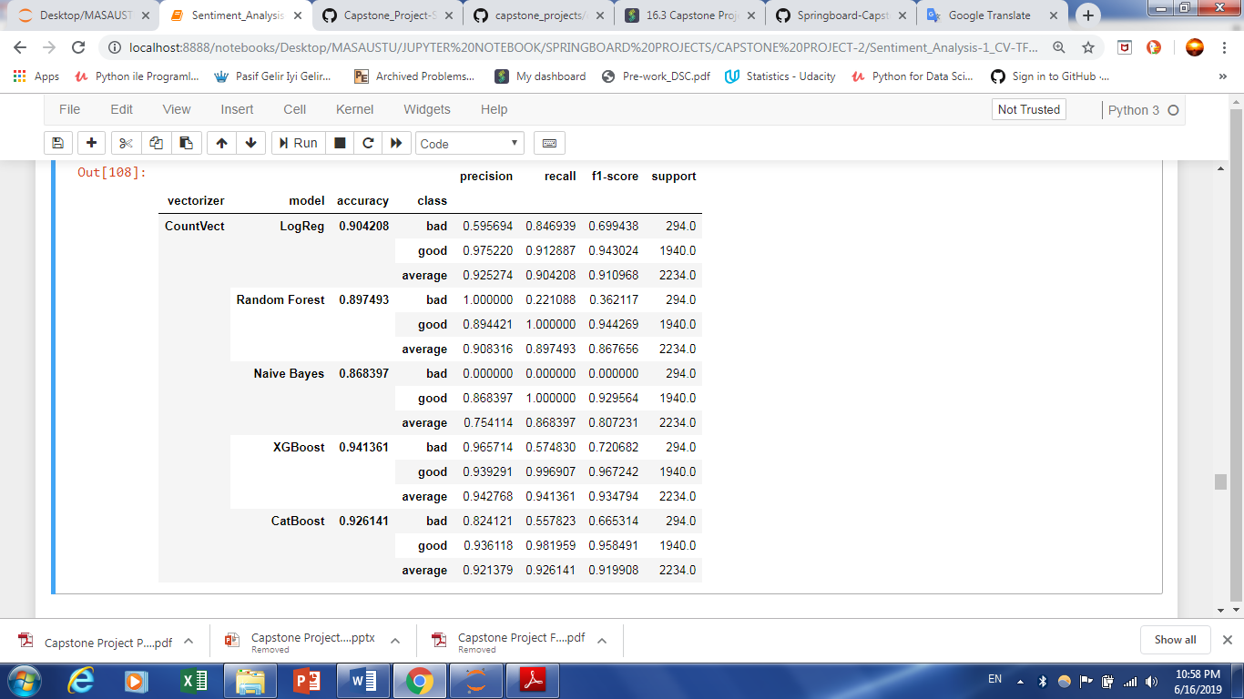
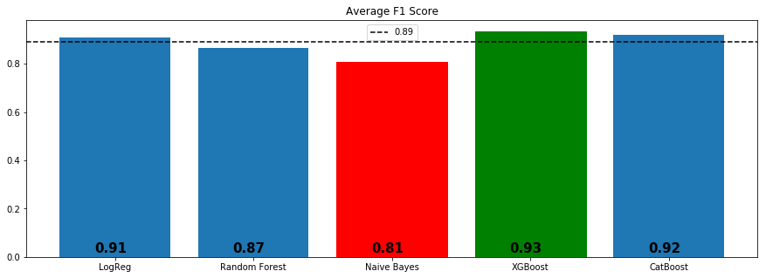
Modeling
TF-IDF and Algorithms
XGboost ➔ 0.934794

Slide 23
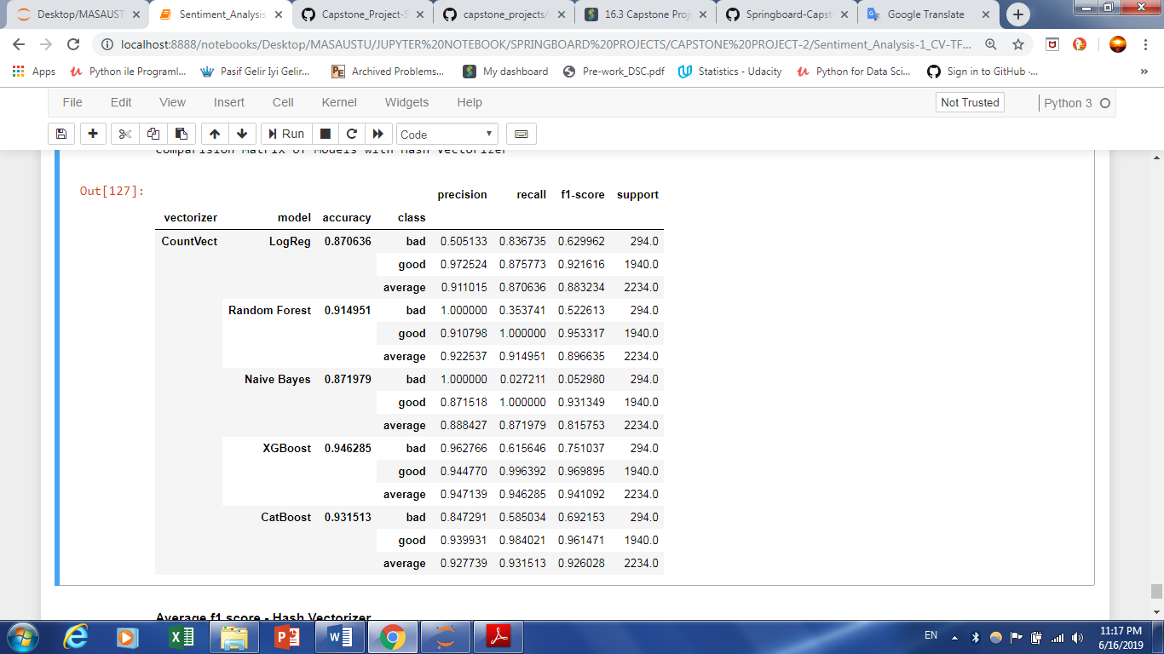
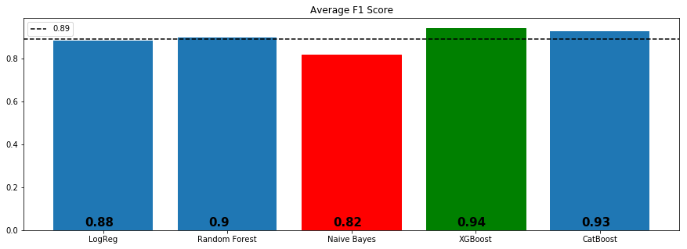
Modeling
Hashing Vectorizing and Algorithms
XGboost ➔ 0.941092

Slide 24
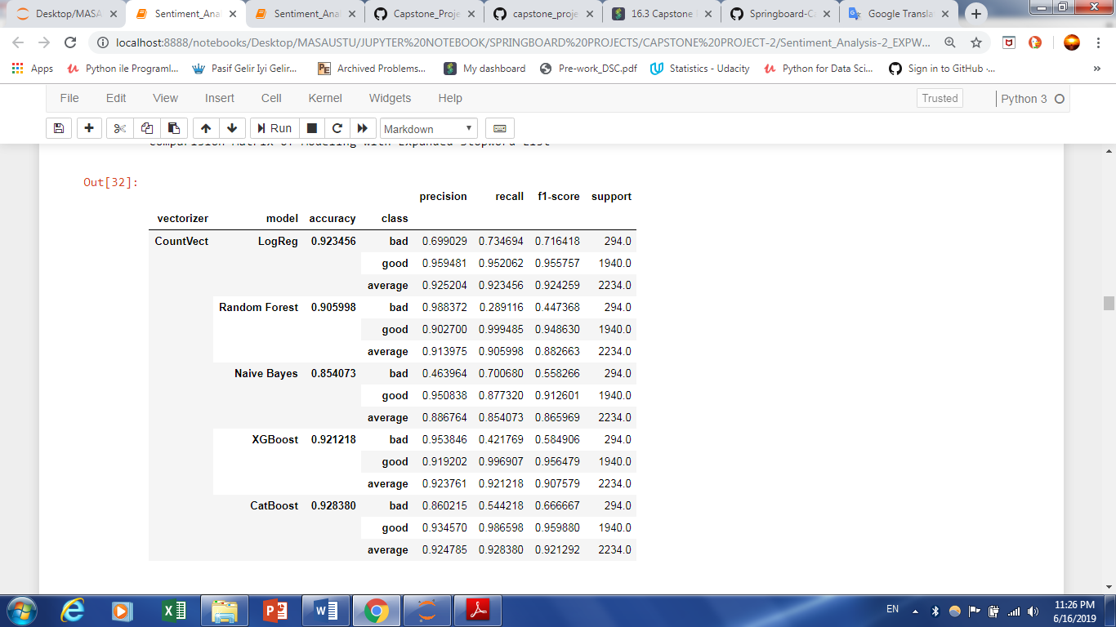
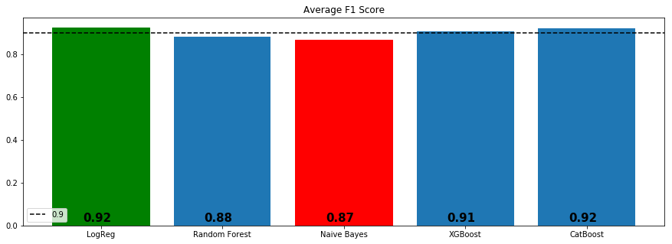
Modeling
Count-Vectorizing and Algorithms - Adding Most and Least Common Words to Stopwords List
Logistic Regression ➔ 0.924259

Slide 25
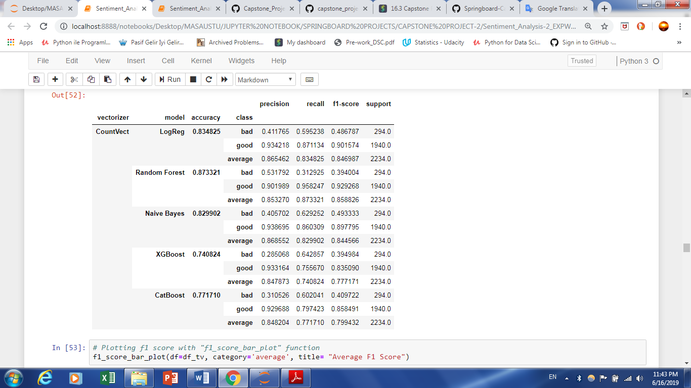
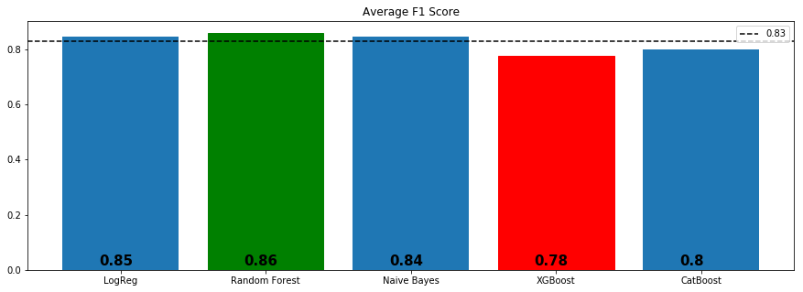
Modeling
Count-Vectorizing and Algorithms - Synthetic Minority Oversampling Technique (SMOTE)
Random Forest ➔ 0.858826

Slide 26
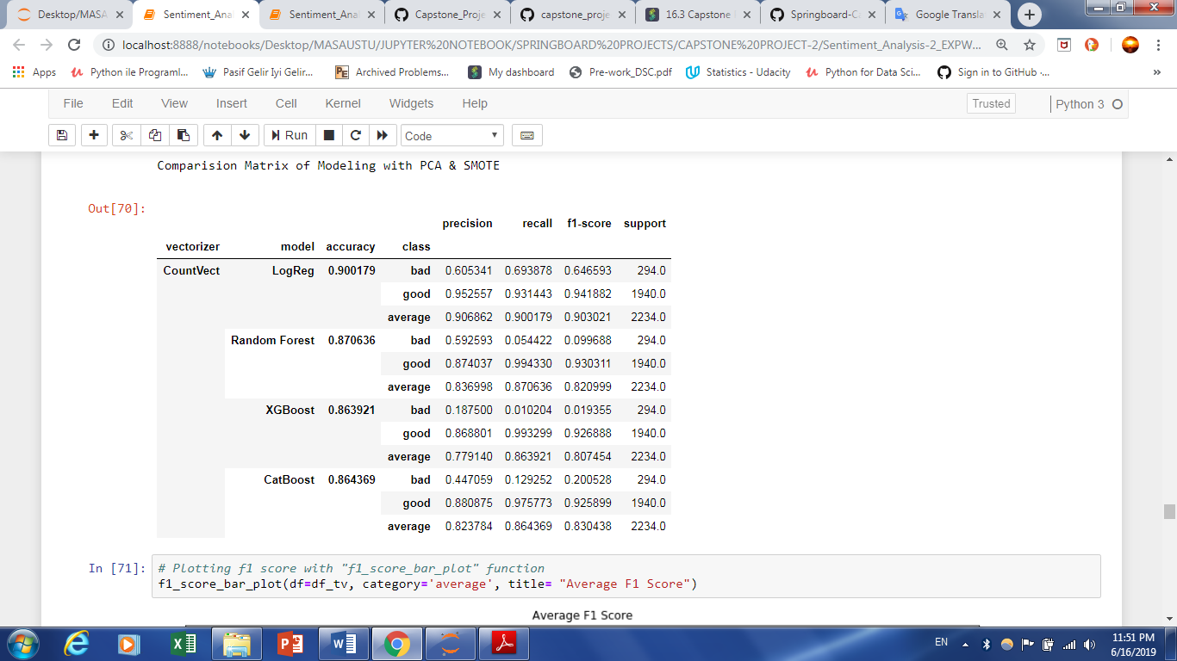
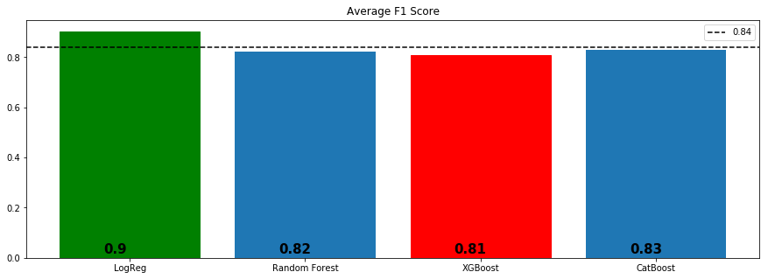
Modeling
Count-Vectorizing and Algorithms - PCA + SMOTE
Logistic Regression ➔ 0.903021

Slide 27
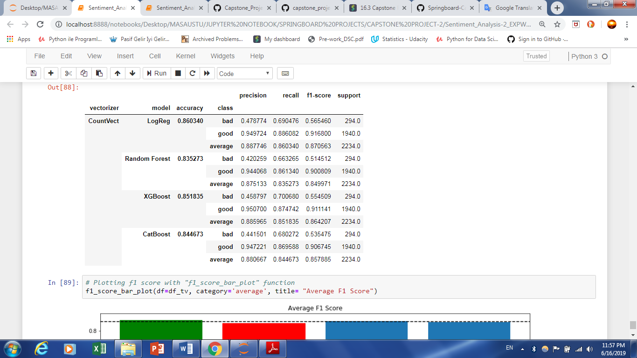
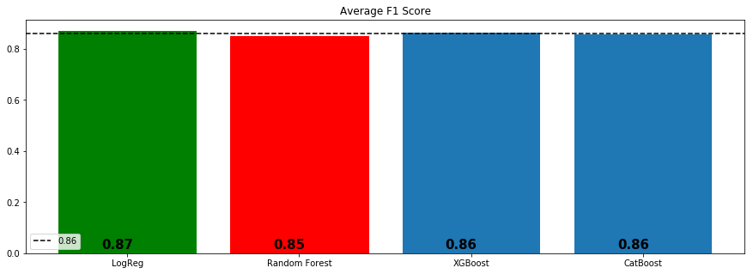
Modeling
Count-Vectorizing and Algorithms - Truncated SVD + SMOTE
Logistic Regression ➔ 0.870563

Slide 28
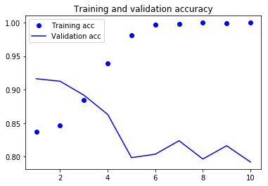
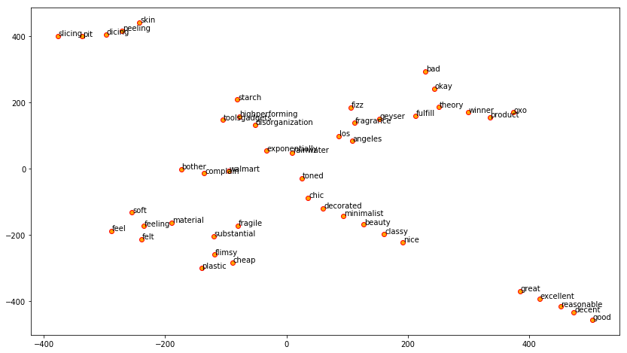
Modeling
Word2Vec and Simple Neural Network
{'feel': ['feeling', 'felt', 'soft', 'substantial', 'material'],
'good': ['decent', 'great', 'nice', 'excellent', 'reasonable'],
'product': ['winner', 'toolsgadgets','disorganization','oxo','highperforming'],
'cheap': ['flimsy', 'fragile', 'plastic', 'walmart', 'exponentially'],
'beauty': ['chic', 'toned', 'minimalist', 'decorated', 'classy'],
'bad': ['complain', 'okay', 'theory', 'fulfill', 'bother'],
'skin': ['peeling', 'starch', 'slicing', 'dicing', 'pit'],
'fragrance': ['fizz', 'los', 'angeles', 'geyser', 'rainwater']}

Slide 29
Summary
In this project, I tried to predict the rating scores based on the reviews left by the customers. Before going through the model result, it is explicitly shown that data set preparation and feature engineering are as much as important as the model creation.
I applied;
- Count Vector, TF-IDF, Hashing Vector, Word2Vec
- Classification Models and Simple Neural Network
- Adding most and least common words to CountVect,
- SMOTE,
- PCA + SMOTE
- Truncated SVD + SMOTE

Slide 30
Conclusion
I would suggest to go with XGboosting with Hash Vectorizing (f1 score is 0.941092) or Logistic Regression with Count Vectorizing (f1 score is 0.937147) in deploying section.
Adding most and least common words to the stop word list did not have impact on models’ performance.
Resampling technique and linear dimensionality reduction did not make a positive improvement of the model accuracy but decreased the model performance.

Slide 31
Recommendations
Use the model as it is for now and develop neural network algorithms to get better scores
Provide a system that user can write their reviews/feedbacks without any restriction
Encourage users to reflect their experience with products via giving incentives.

